Slide 1
Biological Modeling of Neural Networks:
Week 9 – part 1 : Models and data
9.1 What is a good neuron model?
- Models and data
9.4 Generalized Linear Model
- Adding noise to the SRM
9.6. Modeling in vitro data
- how long lasts the effect of a spike?
9.7 Systems neuroscience
- reverse correlations
- helping humans
Week 9 –
Coding and Decoding
Wulfram Gerstner
EPFL, Lausanne, Switzerland
Notes:
Lecture 1: move rapidly through the review, then AdEx on the Blackboard.
Quiz of nullclines in middle of lecture (at about 9:35)
Exercise 1 should start at end of lecture

Slide 2
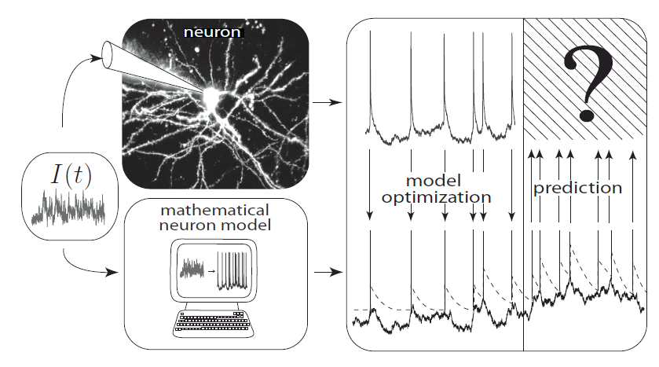
Neuronal Dynamics – 9.1 Neuron Models and Data
in
Intracellular recordings
What is a good neuron model?
Estimate parameters of models?
How does a neuron encode?
Decoding: what do we learn from a spike train?

Slide 3
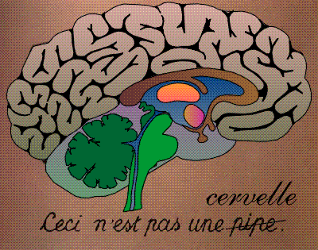
Neuronal Dynamics – 9.1 intro: Systems neuroscience, in vivo
Now: extracellular
recordings
visual
cortex
What is a good ‘processing’ model?
Estimate parameters of models?
How does a neuron encode?
Decoding: what do we learn from a spike train?
Model of ‘Encoding’

Slide 4
Neuronal Dynamics – 9.1 intro: Model of DECODING
Predict stimulus!
visual
cortex
Model of ‘Decoding’:
predict stimulus, given spike times

Slide 5
Biological Modeling of Neural Networks:
Week 9 – part 4 : Generalized linear model
9.1 What is a good neuron model?
- Models and data
9.4 Generalized Linear Model
- for one neuron
9.6. Modeling in vitro data
- how long lasts the effect of a spike?
9.7 Systems neuroscience
- reverse correlations
Week 9 –
Coding and Decoding
Wulfram Gerstner
EPFL, Lausanne, Switzerland
Notes:
Lecture 1: move rapidly through the review, then AdEx on the Blackboard.
Quiz of nullclines in middle of lecture (at about 9:35)
Exercise 1 should start at end of lecture

Slide 6

Spike Response Model (SRM)
Generalized Linear Model GLM
Gerstner et al.,
1992,2000
Truccolo et al., 2005
Pillow et al. 2008
I(t)
S(t)
+
potential
threshold
firing intensity

Slide 7
Neuronal Dynamics – 9.4 Likelihood of a spike train

Slide 8
Neuronal Dynamics – 9.4 SRM with escape noise = GLM
+
linear filters
escape rate
→likelihood of observed
spike train
parameter optimization
of neuron model

Slide 9
Biological Modeling of Neural Networks:
Week 9 – part 6 : Modeling in vitro data
9.1 What is a good neuron model?
- Models and data
9.4 Generalized Linear Model
- for one neuron
9.6. Modeling in vitro data
- how long lasts the effect of a spike?
9.7 Systems neuroscience
- reverse correlations
- helping humans
Week 9 –
Coding and Decoding
Wulfram Gerstner
EPFL, Lausanne, Switzerland
Notes:
Lecture 1: move rapidly through the review, then AdEx on the Blackboard.
Quiz of nullclines in middle of lecture (at about 9:35)
Exercise 1 should start at end of lecture

Slide 10
Neuronal Dynamics – 9.6 Models and Data
comparison model-data
Predict
Subthreshold voltage
Spike times

Slide 11
Neuronal Dynamics – 9.6 GLM/SRM with escape noise
Jolivet&Gerstner, 2005
Paninski et al., 2004
Pillow et al. 2008
I(t)
S(t)
+
potential
threshold
firing intensity

Slide 12
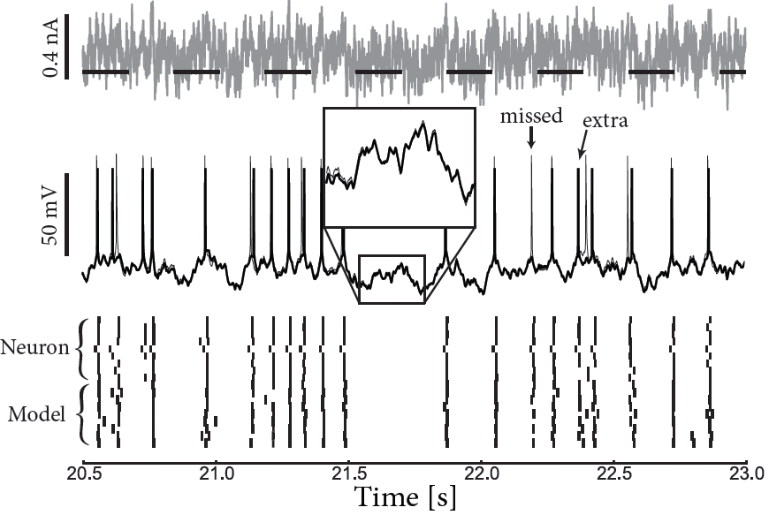
Neuronal Dynamics – 9.6 GLM/SRM predict subthreshold voltage
neuron
Image:Mensi et al.
model

Slide 13
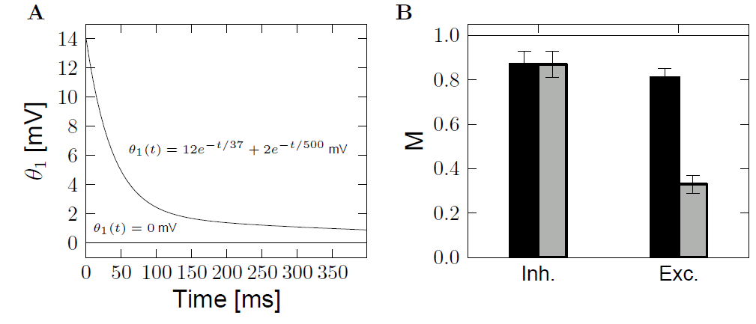
Neuronal Dynamics – 9.6 GLM/SRM predict spike times
Role of moving threshold
No moving threshold
With moving threshold
Mensi et al., 2012

Slide 14
Change in model formulation:
‘soft-threshold
adaptive IF model’
What are the units of …. ?
exponential
I(t)
S(t)
+
adaptation
current
potential
threshold
firing intensity

Slide 15
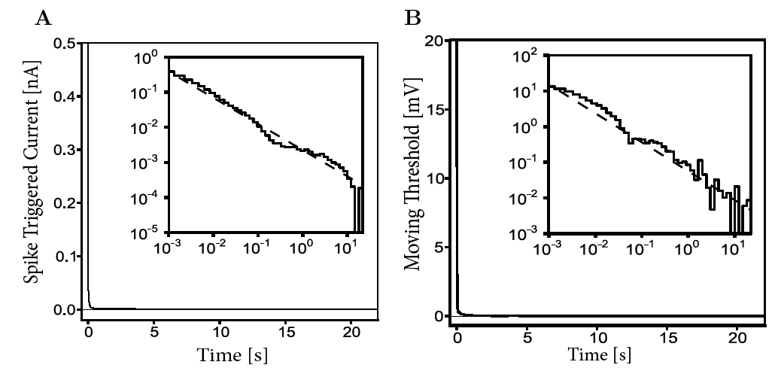
Neuronal Dynamics – 9.6 How long does the effect of a spike last?
Time scale of filters?
→ Power law
A single spike has a measurable effect
more than 10 seconds later!
Pozzorini et al. 2013

Slide 16
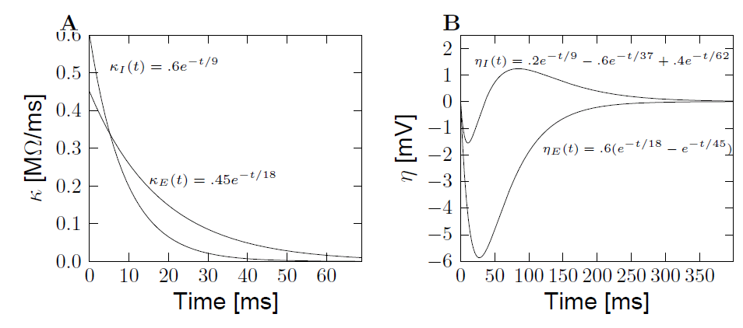
Neuronal Dynamics – 9.6 Extracted parameters: voltage
Subthreshold
potential
known input
known spike train
inhibitory
interneuron
pyramidal
pyramidal
Mensi et al., 2012

Slide 17
Neuronal Dynamics – 9.6 Models and Data
-Predict spike times
-Predict subthreshold voltage
-Easy to interpret (not a ‘black box’)
-Variety of phenomena
-Systematic: ‘optimize’ parameters
BUT so far limited to in vitro

Slide 18
Biological Modeling of Neural Networks:
Week 9 – part 7 : Models and data
9.1 What is a good neuron model?
- Models and data
9.4 Generalized Linear Model
- Adding noise to the SRM
9.6. Modeling in vitro data
- how long lasts the effect of a spike?
9.7 Systems neuroscience
- reverse correlations
- helping humans
Week 9 –
Coding and Decoding
Wulfram Gerstner
EPFL, Lausanne, Switzerland
Notes:
Lecture 1: move rapidly through the review, then AdEx on the Blackboard.
Quiz of nullclines in middle of lecture (at about 9:35)
Exercise 1 should start at end of lecture

Slide 19
Neuronal Dynamics – Review: Models and Data
-Predict spike times
-Predict subthreshold voltage
-Easy to interpret (not a ‘black box’)
-Variety of phenomena
-Systematic: ‘optimize’ parameters
BUT so far limited to in vitro

Slide 20
Neuronal Dynamics – 9.7 Systems neuroscience, in vivo
Now: extracellular
recordings
visual
cortex
Predict spike times, given stimulus
Predict subthreshold voltage
Easy to interpret (not a ‘black box’)
Flexible enough to account for a variety of phenomena
Systematic procedure to ‘optimize’ parameters
Model of ‘Encoding’

Slide 21
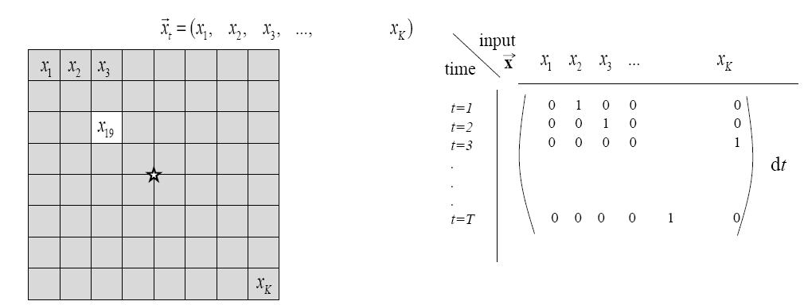
Neuronal Dynamics – 9.7 Estimation of receptive fields
Estimation of spatial (and temporal) receptive fields
LNP
firing intensity

Slide 22
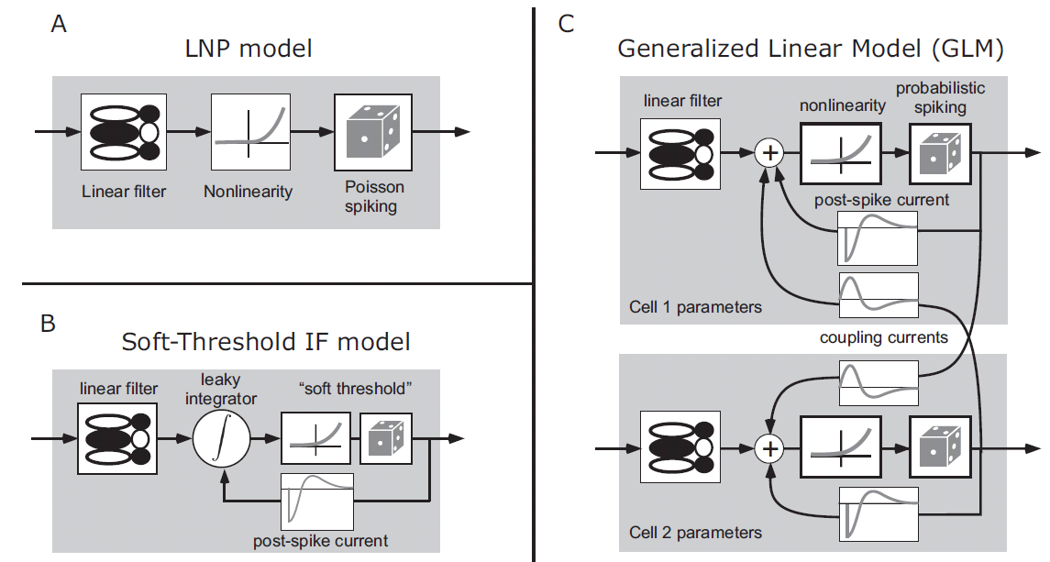
Neuronal Dynamics – 9.7 Estimation of Receptive Fields
visual
stimulus
LNP =
Linear-Nonlinear-Poisson
Special case of
GLM=
Generalized Linear Model

Slide 23
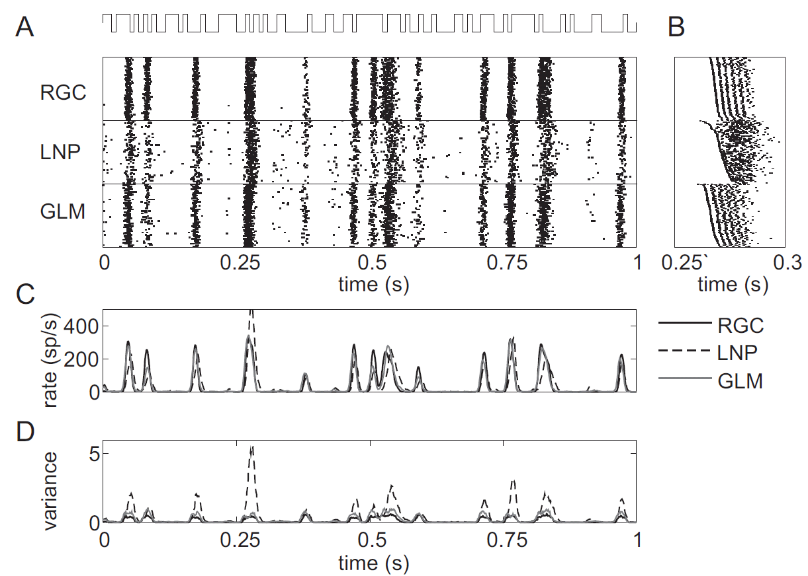
Neuronal Dynamics – 9.7 Estimation of Receptive Fields
GLM for prediction of retinal ganglion ON cell activity
Data from Retinal
Ganglion Cells
LNP
worse than
GLM
Pillow et al. 2008

Slide 24
Neuronal Dynamics – 9.7 GLM with lateral coupling

Slide 25
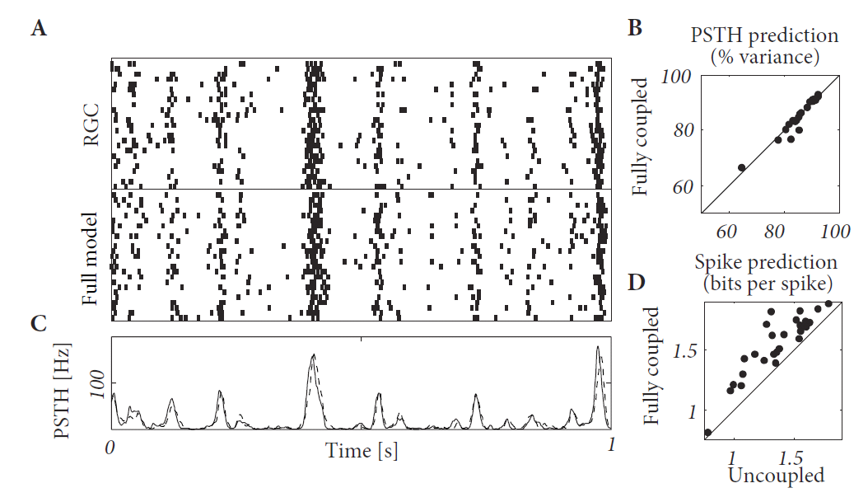
Neuronal Dynamics – 9.7 GLM with lateral coupling
One cell in a Network of Ganglion cells
Pillow et al. 2008
coupled
GLM
Better than
Uncoupled GLM
Image:
Gerstner et al.,
Neuronal Dynamics,
Cambridge 2014

Slide 26
Neuronal Dynamics – 9.7 Model of ENCODING
visual
cortex
Predict spike times, given stimulus
Predict subthreshold voltage
Easy to interpret (not a ‘black box’)
Flexible enough to account for a variety of phenomena
Systematic procedure to ‘optimize’ parameters
Model of ‘Encoding’

Slide 27
Neuronal Dynamics – 9.7 ENCODING and Decoding
Model of ‘Encoding’
Generalized Linear Model (GLM)
- flexible model
- systematic optimization
of parameters
Model of ‘Decoding’
The same GLM works!
- flexible model
- systematic optimization
of parameters

Slide 28
Neuronal Dynamics – 9.7 Model of DECODING
Predict stimulus!
visual
cortex
Model of ‘Decoding’:
predict stimulus, given spike times

Slide 29
Neuronal Dynamics – 9.7 Helping Humans
Application: Neuroprosthetics
frontal
cortex
Many groups
world wide
work on this
problem!
motor
cortex
Model of
‘Decoding’
Predict intended arm movement,
given Spike Times

Slide 30
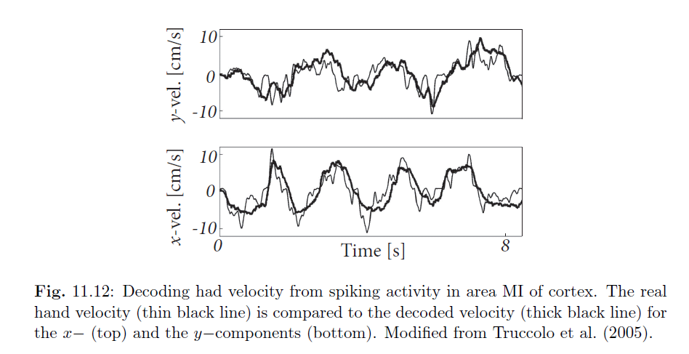
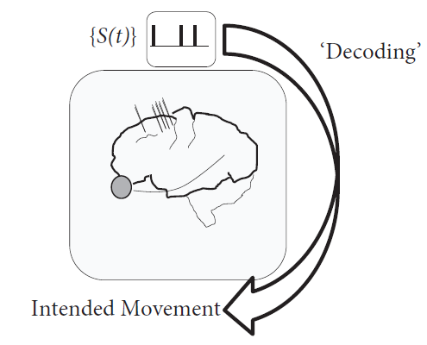
Neuronal Dynamics – 9.7 Basic neuroprosthetics
Application: Neuroprosthetics
Decode the intended arm movement
Hand velocity
Image:
Gerstner et al.,
Neuronal Dynamics,
Cambridge 2014

Slide 31
Neuronal Dynamics – 9.7 Why mathematical models?
Mathematical models
for neuroscience
help humans
The end

Slide 32
Neuronal Dynamics week 9– Suggested Reading/selected references
Reading: W. Gerstner, W.M. Kistler, R. Naud and L. Paninski,
Neuronal Dynamics: from single neurons to networks and models of cognition. Ch. 10,11: Cambridge, 2014
Optimization methods for neuron models, max likelihood, and GLM
-Brillinger, D. R. (1988). Maximum likelihood analysis of spike trains of interacting nerve cells. Biol. Cybern., 59:189-200.
-Truccolo, et al. (2005). A point process framework for relating neural spiking activity to spiking history, neural ensemble, and extrinsic covariate effects. Journal of Neurophysiology, 93:1074-1089.
- Paninski, L. (2004). Maximum likelihood estimation of … Network: Computation in Neural Systems, 15:243-262.
- Paninski, L., Pillow, J., and Lewi, J. (2007). Statistical models for neural encoding, decoding, and optimal
stimulus design. In Cisek, P., et al. , Comput. Neuroscience: Theoretical Insights into Brain Function. Elsevier Science.
Pillow, J., ET AL.(2008). Spatio-temporal correlations and visual signalling… . Nature, 454:995-999.
Rieke, F., Warland, D., de Ruyter van Steveninck, R., and Bialek, W. (1997). Spikes - Exploring the neural code. MIT Press,
Keat, J., Reinagel, P., Reid, R., and Meister, M. (2001). Predicting every spike … Neuron, 30:803-817.
Mensi, S., et al. (2012). Parameter extraction and classication …. J. Neurophys.,107:1756-1775.
Pozzorini, C., Naud, R., Mensi, S., and Gerstner, W. (2013). Temporal whitening by . Nat. Neuroscience,
Georgopoulos, A. P., Schwartz, A.,Kettner, R. E. (1986). Neuronal population coding of movement direction. Science, 233:1416-1419.
Donoghue, J. (2002). Connecting cortex to machines: recent advances in brain interfaces. Nat. Neurosci., 5:1085-1088.
Encoding and Decoding

